Slide 1

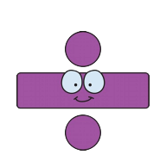
MTC year 4

Slide 2
Aims
Importance of times tables and an understanding of how times tables is taught
National curriculum expectations
To achieve an understanding of what the Multiplication Tables Check (MTC) is and how the Multiplication Tables Check will be administered
Top Tips
144 facts reduced to 36 facts
To provide you with a range of strategies and websites you can use with your child at home

Slide 3
Importance of times table knowledge
Learning times tables off by heart makes mental maths much easier. It will boost your child’s confidence in their maths lessons at school and help them to move quickly through more complex maths concepts and problems.
Not knowing your times tables puts additional strain on your working memory when tackling such new concepts in maths. This will hinder the long-term transition of the new facts to the long-term memory.
Times tables are fundamental to many maths topics, especially fractions.
Multiplication and division feature very highly in the KS2 SATs reasoning papers.

Slide 4
National curriculum requirements
Year 1 times tables learning
Children are taught the simplest form of multiplication, counting up in 2s, 5s and 10s.
Year 2 times table learning
Children are formally introduced to multiplication, related division facts and repeated addition for the numbers 2, 5 and 10.

Slide 5
National curriculum requirements
Year 3 times table learning
A crucial year for times tables learning. Children are expected to learn multiplication facts for the 3, 4 and 8 times tables and to use practical and written methods to multiply and divide two-digit numbers (for example, 15 x 4).
Year 4 times tables learning
A ‘completing’ year for all multiplication facts up to 12 x 12. Children also continue to develop their skills in multiplication of two-digit numbers by a one-digit number, using harder combinations of numbers. They will also learn to multiply three-digit numbers by a one-digit number.

Slide 6
Multiplication times table check (mtc)

Slide 7
The Department for Education (DfE)
Year 4 multiplication check
The purpose of the MTC is to determine whether year 4 pupils can fluently recall their multiplication tables and are meeting the expected standard for their year group before moving to Upper Key Stage 2 (Year 5 and Year 6)
‘By the end of year 4, pupils should have memorised their multiplication tables up to and including the 12 multiplication table and show precision and fluency in their work’.
School-level results and individual pupil results will be made available to schools. This will allow schools to provide additional support to pupils who require it.
National and local authority results will be reported by the Department for Education (DfE) to track standards over time.
How will the MTC data be used?

Slide 8
The Department for Education (DfE) Year 4 multiplication check
The MTC takes place in the spring term (Monday 1st June until Friday 12th June)
All year 4 children will be required to take the MTC. (children who are working well below year 2 expectations in multiplication may be exempt from taking the check)
If a child cannot access the MTC, a range of access arrangements will be available to support pupils.
There is no ‘pass’ rate or threshold which means that, unlike the Phonics Screening Check, children will not be expected to re-sit the check.
We have the flexibility to administer the check to individual pupils, small groups or a whole class at the same time.
It will be automatically scored, and results will be available to schools once the assessment window closes.

Slide 9
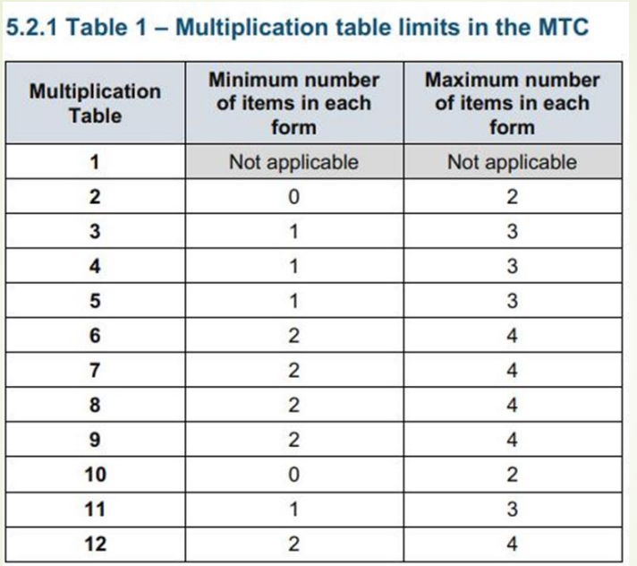
The Department for Education (DfE) Year 4 multiplication check
Answers will be entered using an on-screen number pad.
Usually, the check will take less than 5 minutes for each child.
The children will have 6 seconds from the time the question appears to input their answer.
There will be a total of 25 questions with a 3 second pause in-between questions.
Each child will be randomly assigned a set of questions
There will only be multiplication questions
The 6, 7, 8, 9 and 12 times tables are more likely
• 6 x 6, 6 x 7, 6 x 8, 6 x 9, 6 x 12
• 7 x 8, 7 x 9, 7 x 12
• 8 x 9, 8 x 12
• 12 x 12

Slide 10
Teaching strategies

Slide 11
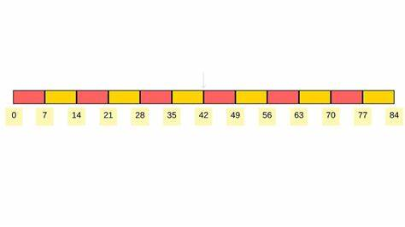
Counting stick

Slide 12

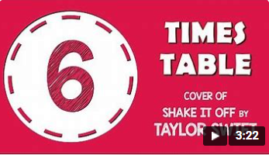
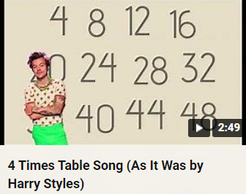
Rhymes and songs
Rhymes and songs are so important because they support the retention of facts by making them fun and memorable to learn.
6 x 7 and 7 x 6 | Fancy a trip to the zoo? 6 times 7 is 42 At the zoo, I saw elephant poo… 7 times 6 is 42
8 x 8 | I ate and ate ‘til I was sick on the floor… 8 times 8 is 64

Slide 13
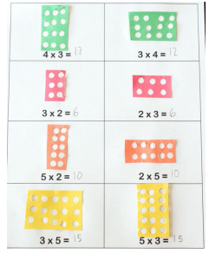
Multiplication is commutative
factor
factor
product
factor
factor
3 x 2 = 6 = 2 x 3
Same as
Equal to
Children need to understand that multiplication can be completed in any order but will still produce the same product.

Slide 14
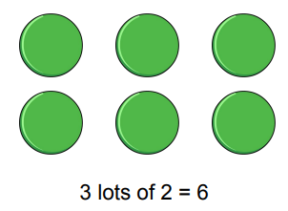
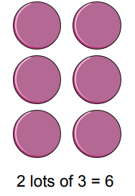
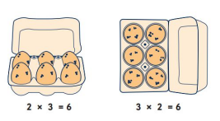
Arrays
Arrays are a visual method of representing multiplication.
The product of 3 x 2 is the same as 2 x 3 but the image is different.
2s 3 times
3s 2 times

Slide 15
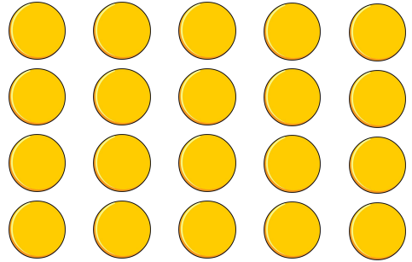
Division is the Inverse of multiplication
20 ÷ 5 = 4 can be worked out because 5 x 4 = 20
Using pictorial representations (such as arrays) is useful here for children to see the link between multiplication and division.

Slide 16
Fact Families
Due to their commutative understanding, children should also be able to see whole number families.
7 x 5 = 35
5 x 7 = 35
35 = 5 x 7
35 = 7 x 5
35
35 ÷ 5 = 7
35 ÷ 7 = 5
7 = 35 ÷ 5
5 = 35 ÷ 7
7
5

Slide 17
Using known facts
By using known facts from ‘other’ times tables, children are able to find answers with increasing speed.
4 x 6 = ?
I know 4 x 5 = 20
Therefore, 20 + 4 = 24
17 x 7 = ?
I know 10 x 7 = 70 and 7 x 7 = 49
Therefore, 70 + 49 = 119
If 4 x 9 = 36
I can work out 4 x 90 = 360
and 4 x 900 = 3600
Therefore, I know 40 x 9 = 360
and 400 x 9 = 3600
8 x 9 = ?
I know 8 x 10 = 80
Therefore, 80 - 8 = 72

Slide 18
times tables Top Tips

Slide 19
year 2
2x table
Any number multiplied by two is double the number. 7 x 2 =14 7 + 7 = 14 double 7 is 14
5x table
All multiples of 5 end in five or zero. Any odd number times 5 ends in a 5. Any even number times 5 ends in 0.
10x table
All the digits in the ten times table end in zero

Slide 20
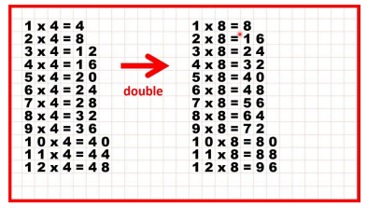
year 3
The 4 and 8 times tables are introduced as related to the 2 times tables (doubling each time). 6, 4, 2, 0).
The ones digits in the multiples of eight also go down in twos.
8, 16, 24, 32, 40, 48, 56, 64, 72, 80
(8, 6, 4, 2, 0, 8, 6, 4, 2, 0).
In the 3 x table, if you add up the sum of the digits they are always multiples of 3. For example: 3, 6, 9, 12 (1+2=3), 15 (1+5=6), 18 (1+8=9) 21 (2+1=3), 24 (2+4=6) etc.
The numbers also follow the pattern of: odd, even, odd, even (3,6,9,12).

Slide 21
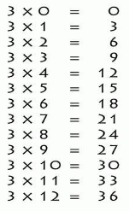
year 3
In the 3 x table, if you add up the sum of the digits they are always multiples of 3.
For example: 3, 6, 9, 12 (1+2=3), 15 (1+5=6), 18 (1+8=9) 21 (2+1=3), 24 (2+4=6) etc.
The numbers also follow the pattern of: odd, even, odd, even (3,6,9,12).

Slide 22
year 4
Top hints
6x table
The six times table is double the three times table. So 5 x 3 = 15, 5 x 6 = 30, 30 is double 15.
7x table
Combine the 5 and the 2 times table: 7 x 4 = 28 or (5x4) + (2x4) = 28
Odd and Even Numbers
E = even O = odd
The following rules always apply:
E x E = E E x O = E O x E = E O x O = O
2 x 6 = 12 4 x 5 = 20 9 x 2 = 18 7 x 3 = 21
The only time you get an odd answer is when two odd numbers are multiplied together.

Slide 23
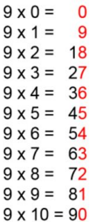
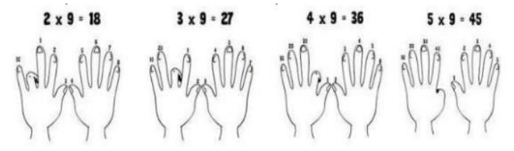
year 4
Top hints
9x table
Fingers can be used to work out the nine times table up to 10 x 9. The first finger is put down for 1 x 9 and the remaining fingers show 9 ones (1 x 9 =9). Then the second finer is put down for 2 x 9 and the remaining fingers show 1 ten (to the left) and 8 ones (to the right) which equals 18, and so on.
The digits found in the multiples of nine when added together also equal nine.
For example: 9 = 9, 18 (1 + 8) = 9, 27 (2 + 7) = 9, 36 (3 + 6) = 9, 45 (4 + 5) = 9 etc.

Slide 24
How to reduce the number of facts to learn?

Slide 25
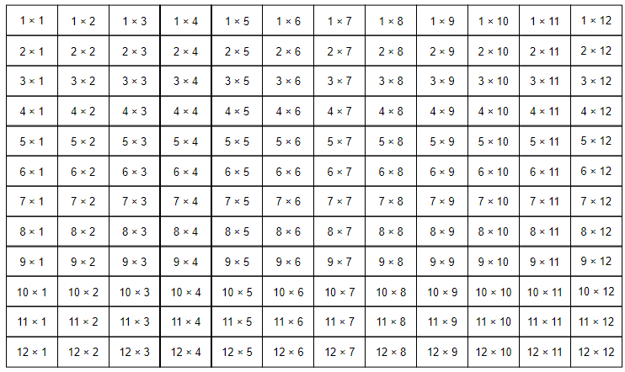
144 multiplication facts

Slide 26
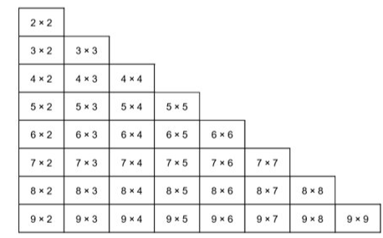
36 multiplication facts

Slide 27
Support at home

Slide 28
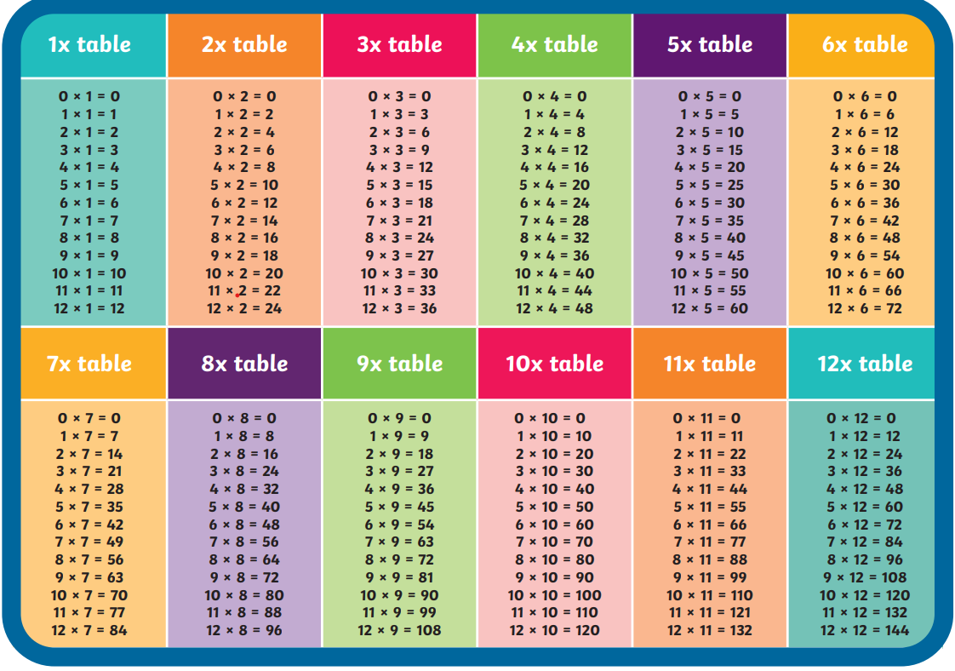

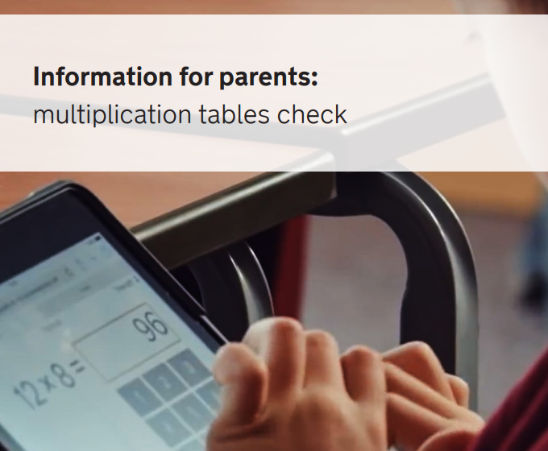
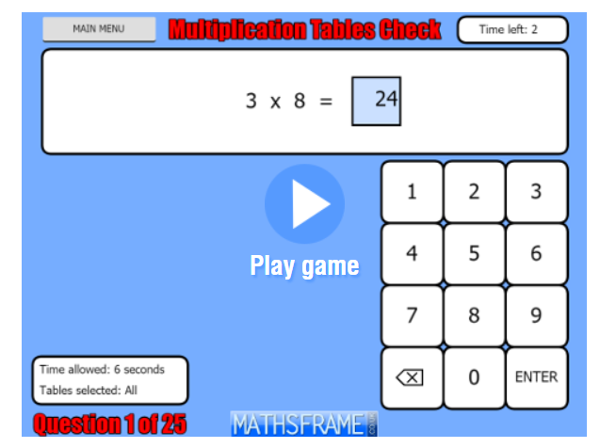
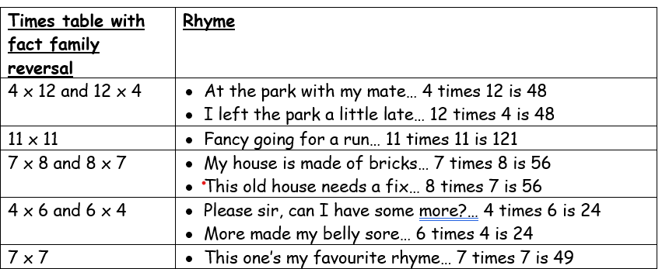
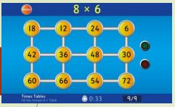

If your child is practising regularly at home, they are practising for the benefit of their wider maths education

Slide 29
Thank you for coming

